Slide 1

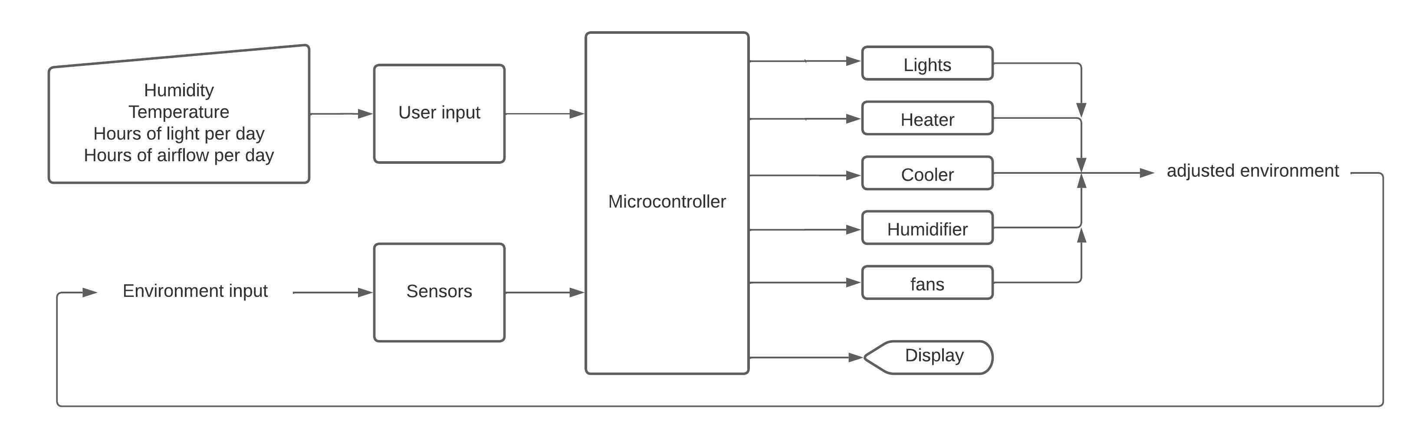
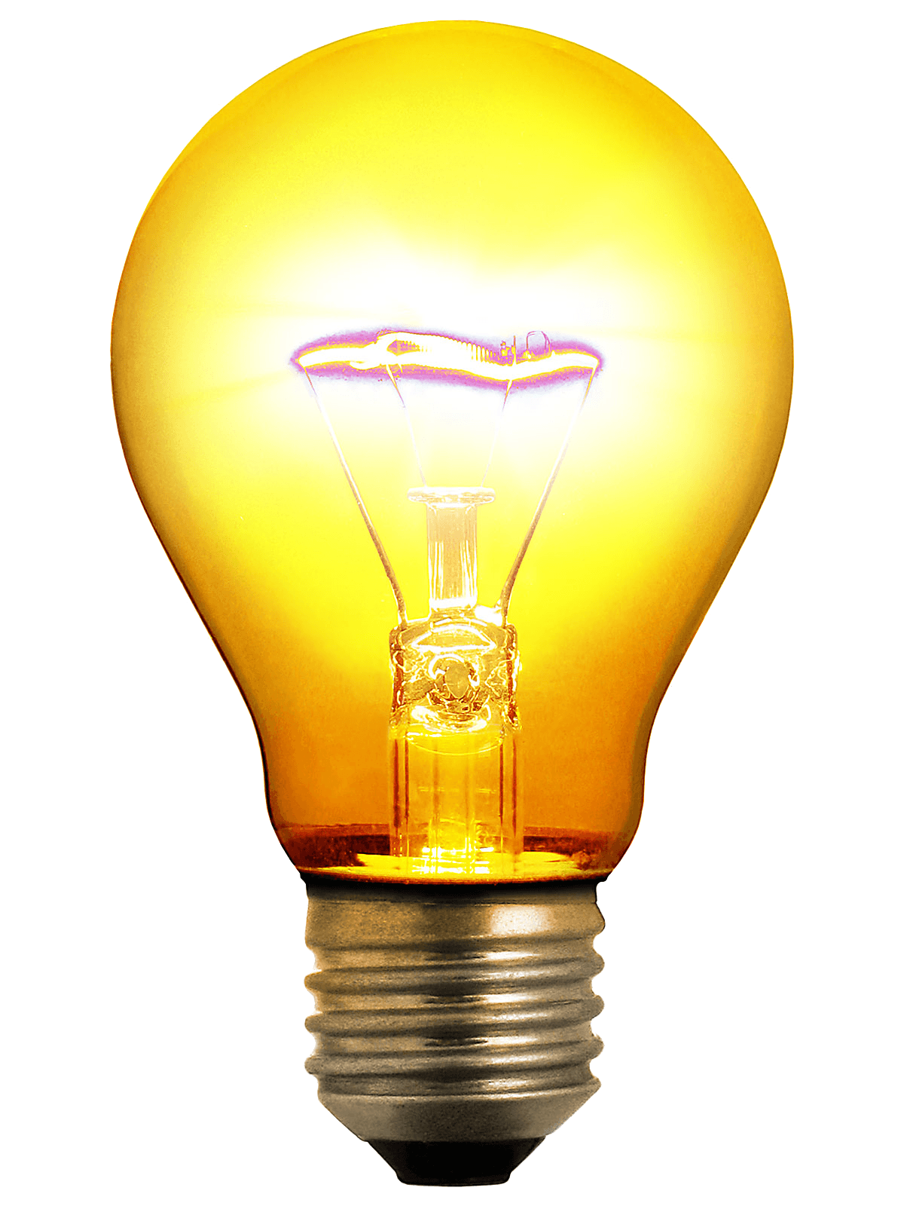
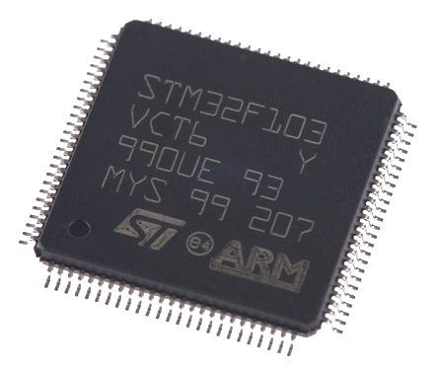

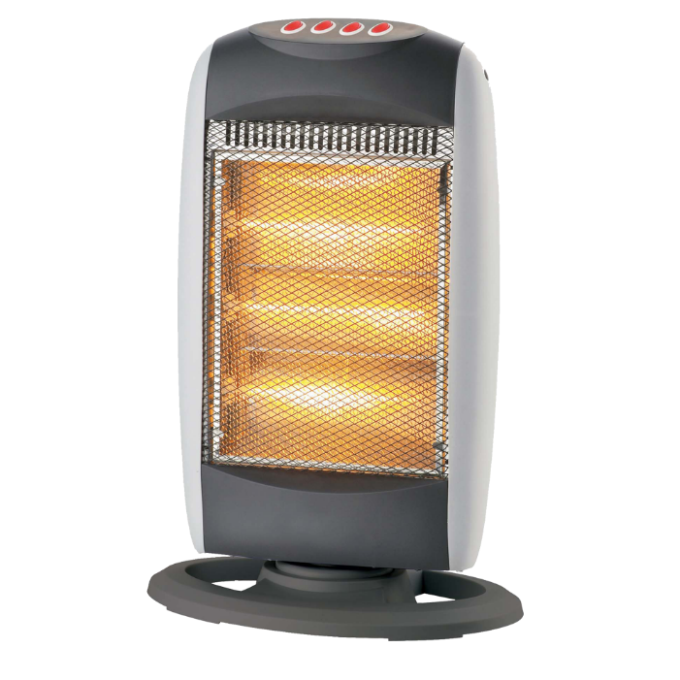
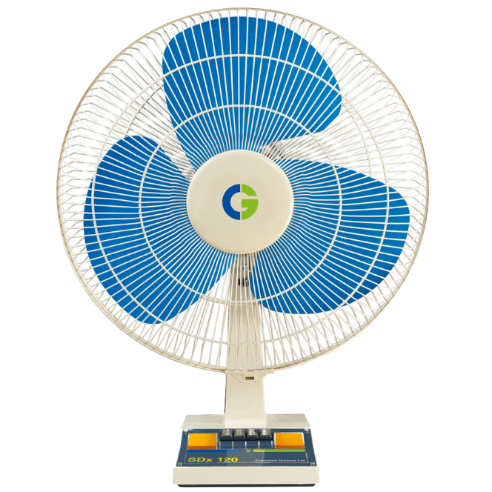

GreenBox
Project
Raising and caring for plant life are some of the most fundamental things we do as a species.
Caring for plants on a small scale can have many benefits.
Farms, especially large commercial farms, are heavily automated to ensure positive results.
GreenBox brings some of this automation into the home, along with its results!
GreenBox combines existing technology with a control system to maintain a desired level of temperature, humidity, light, and air.
System
Methods
Conclusion
The original goal of this project was to monitor and adjust the temperature, humidity, light, and air-flow in the main chamber.
These goals were all met.
Many lessons were learned through this project, many about the importance of flexibility in planning.
In the future, this could become a product that does an even better job of maintaining conditions, as well as having more features such as wireless connectivity.
Utilizes existing environmental control technologies.
Controls these technologies using a microcontroller, sensors, and timers.
Controls each subsystem’s power source to allow scaling and increase repairability.
Features simple and easy user interface.
Zach Wilcox – Zacdwil@hotmail.com
Notes:
1 more bullet point in methods
White space between titles and text.
Parallel structure inn project

